Slide 1
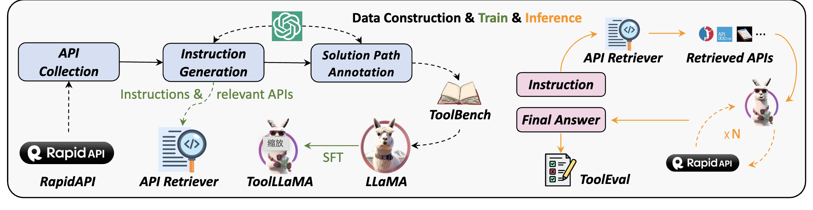

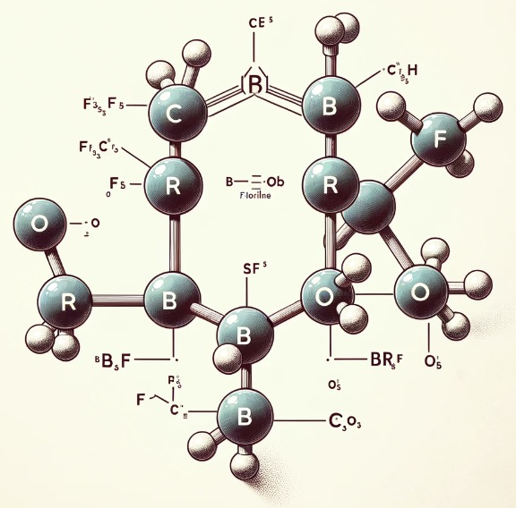
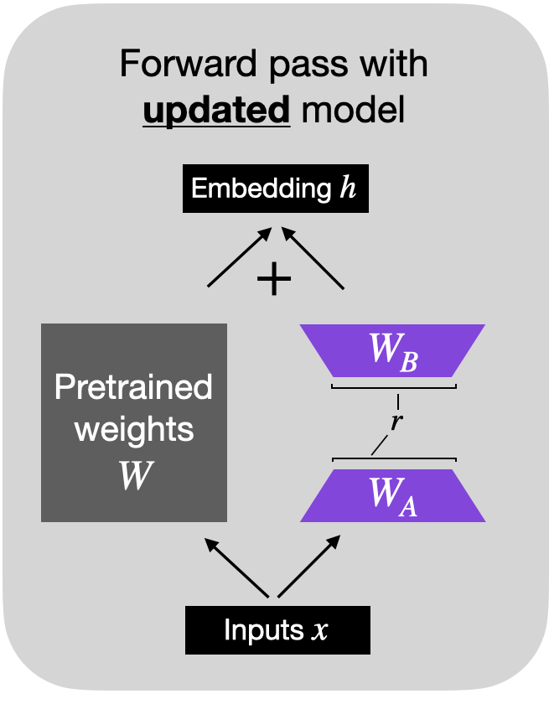
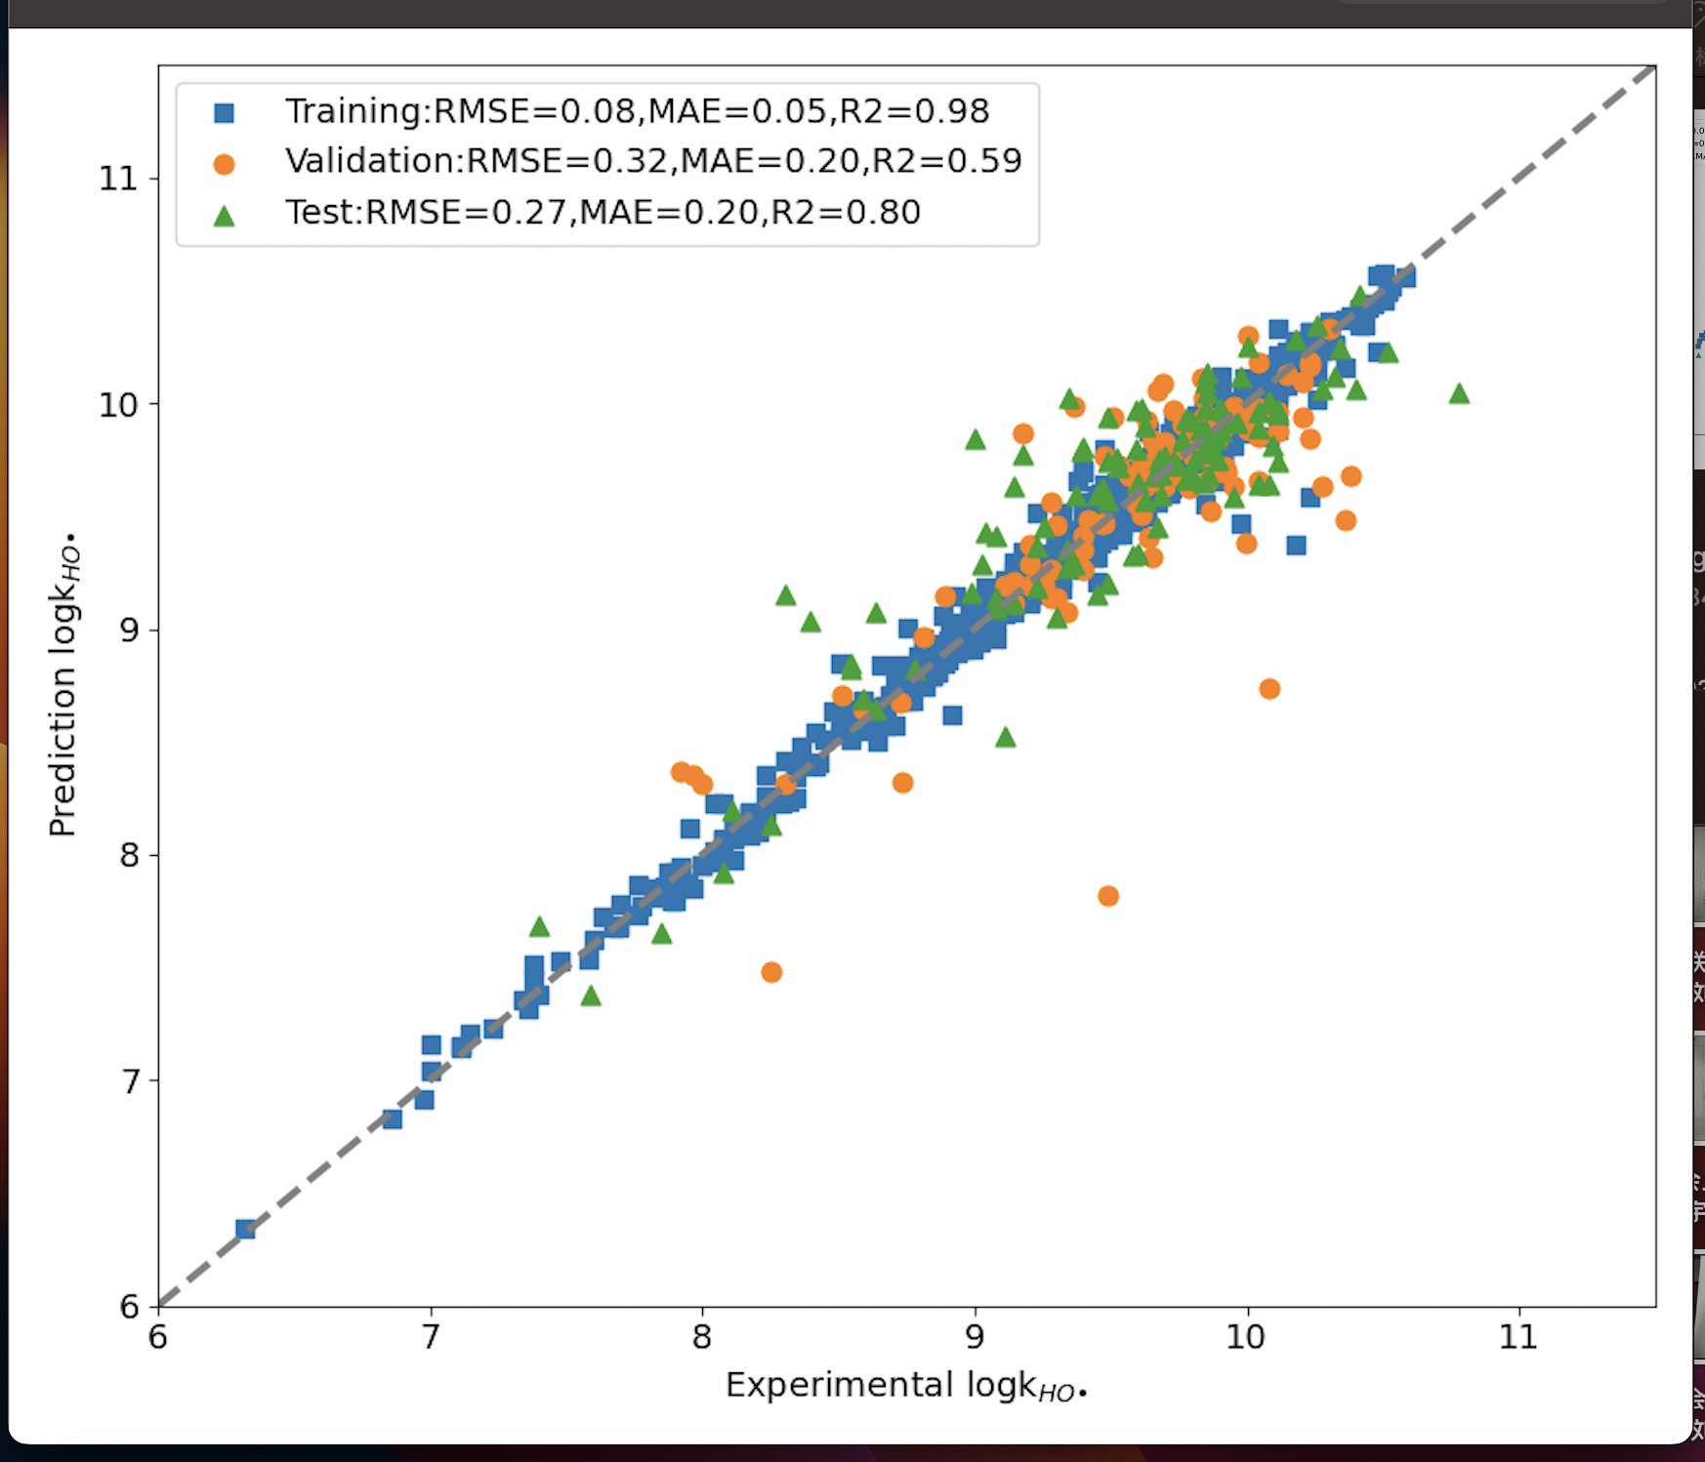
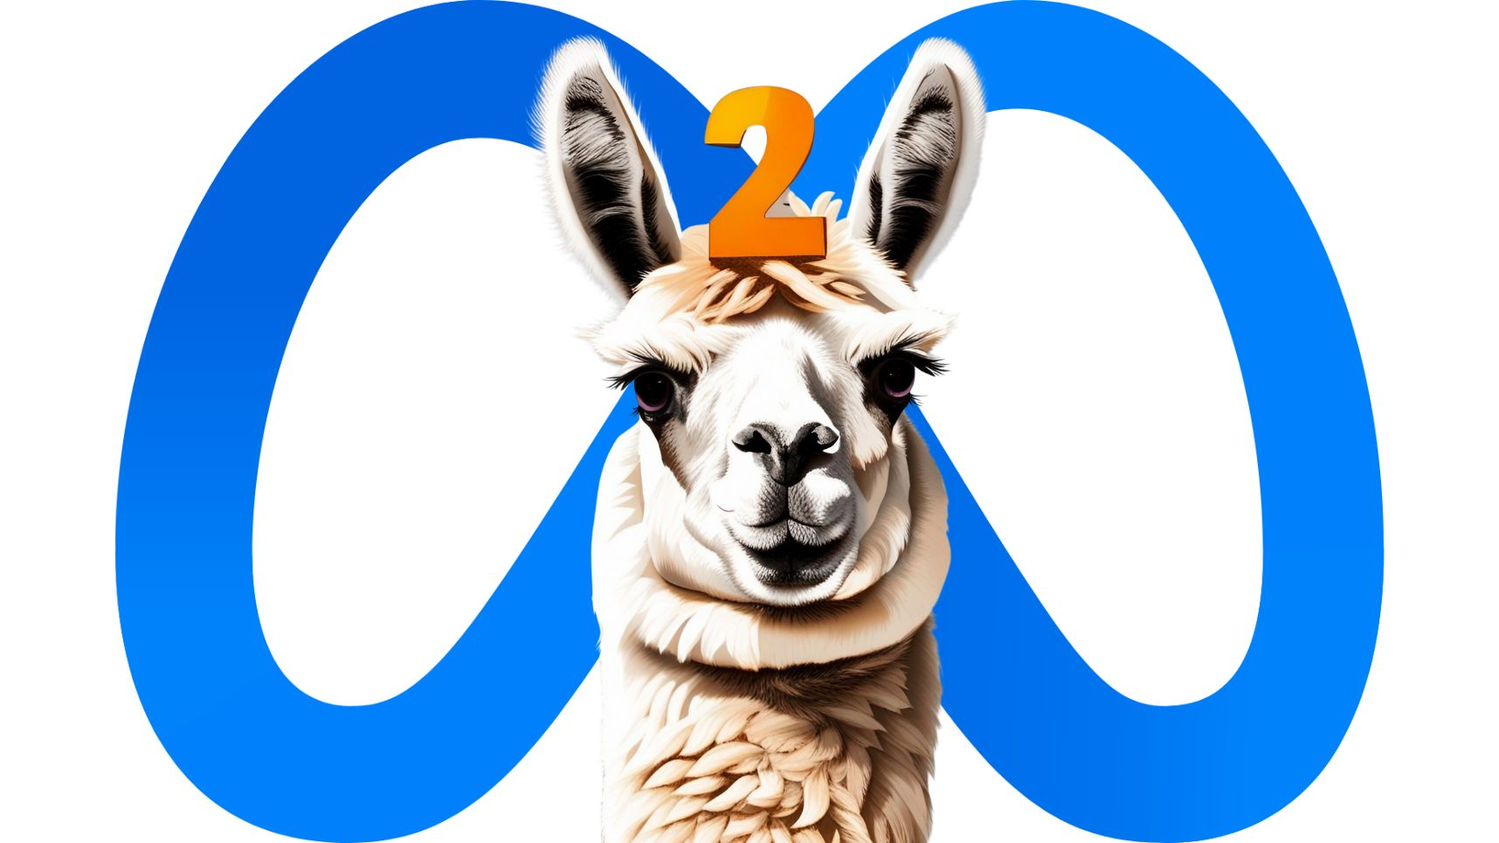
Data Construction
SMILES: FC(F)(F)C(Br)(C(Br)=O)C(F)(F)F
Instruction and QA dialgoue generation
how long the half-life of …
Answer: 3.5
Half life: 4.57
LoRA finetuning
Inference
Llama13B-chat

Slide 2
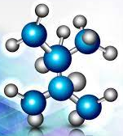
Data Construction
SMILES: FC(F)(F)C(Br)(C(Br)=O)C(F)(F)F
Half life: 4.57
Instruction and QA dialogue generation
How long the half-life of FC...(F)F ?
Answer: 3.5
Original Knowledge
Annotated knowledge
Inference
LoRA finetuning
CoT
Llama13B-chat

Slide 3


SMILES: FC(F)(F)C(Br)(C(Br)=O)C(F)(F)F
Half life: 4.57
Instruction and QA dialogue generation
How long the half-life of FC...(F)F ?
Answer: 3.5
Annotated knowledge
Inference
LoRA finetuning
CoT
Llama13B-chat

